Slide 1
Biomarkers and smoking
August 5, 2022

Slide 2
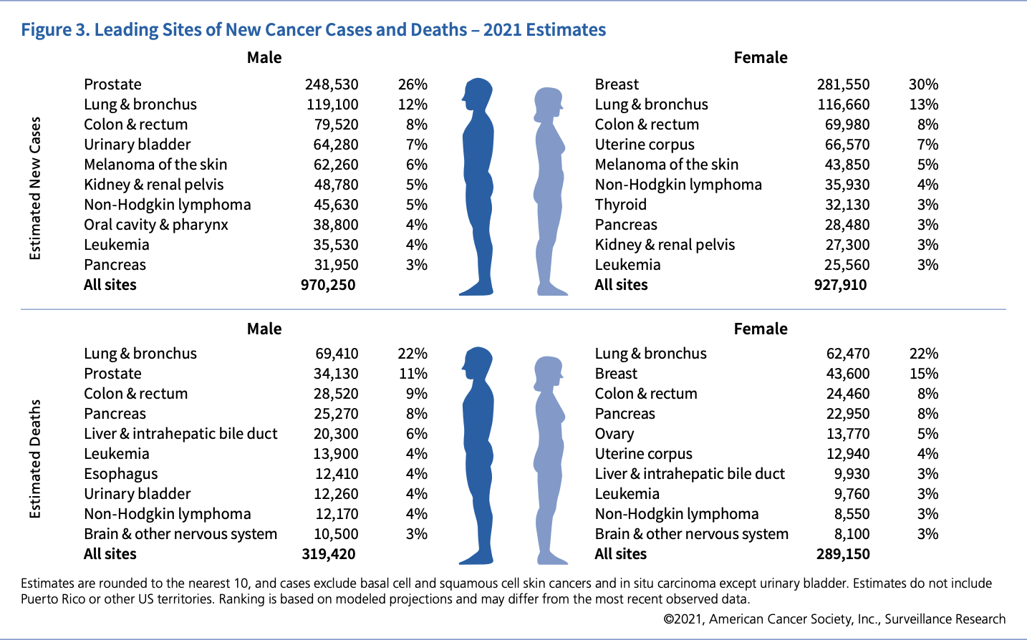


Background

Slide 3
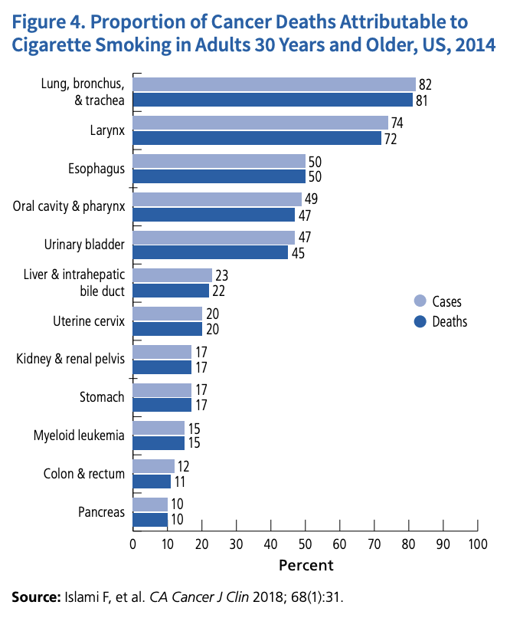

Background
Cytology is the current commonly used urinary test to detect bladder cancer
Kumar et al reported a 13.3% sensitivity and 100% specificity
Hajdinjak reported a 42% sensitivity and 96% specificity
We are trying to create a more sensitive urine test
How does smoking impact detection of bladder cancer using urinary biomarkers?
Notes:
Kumar N, Talwar R, Nandy P. Efficacy of voided urinary cytology and ultrasonography compared to cystoscopy in the detection of urinary bladder cancer. African journal of urology. 2017;23:192–6.
Hajdinjak T. UroVysion FISH test for detecting urothelial cancers: meta-analysis of diagnostic accuracy and comparison with urinary cytology testing. Urologic oncology: seminars and original investigations. 2008;26:646–51.

Slide 4
Methods

Slide 5
Demographics

Slide 6
Analysis

Slide 7
Conclusion

Slide 8
Next steps

